Slide 1
Market size | Reginal assessment | Competitor analysis – YouTube
YouTube performance
Estimating the Gross Merchandise Value (GMV) of YouTube
Macro-Influencers
Merchandise sales from the top 20 YouTube earners produce approximately $18M in revenue annually
Micro-Influencers
On average, a Youtuber with 11,000 subscribers will sell around six pieces of merchandise every month to accumulate around $70 (or $840 per year)
Gross Merchandise Value Estimate
Assuming a logarithmic relationship between subscriber count and merchandise sales, we can estimate that, if all youtubers promoted merchandise to their audience, the total annual revenue from merchandise sold via YouTube could potentially reach $692B.
Source: LSC analysis

Slide 2
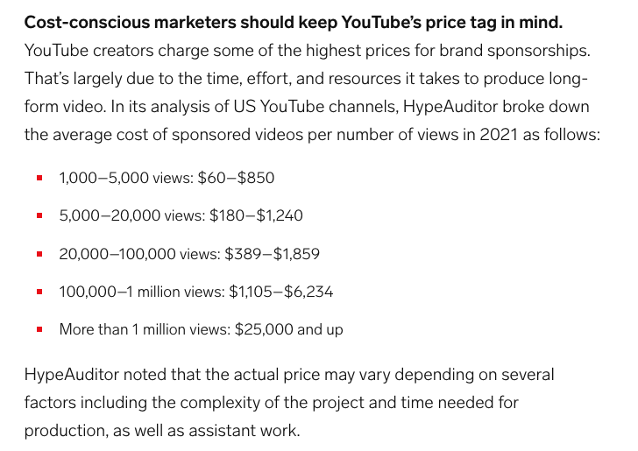

Market size | End-user insights | Competitor analysis – YouTube
YouTube performance
Monetisation
Potential earnings from brand sponsorship deals
Trending keywords (relevant to Unifuture) sized by how much advertisers are willing to bid for that type of content
Trending keyword | Top of page bid (high range)
livestream | £11.86
highlights | £7.64
science | £2.57
vlog | £2.56
reacting | £1.94
tutorial | £1.86
education | £1.53
comedy | £1.14
how to | £1.14
family | £0.99
interview | £0.97
challenge | £0.72
cooking | £0.71
shorts | £0.68
Potential Ad Revenue can be a useful metric for assessing how easy a certain type of content is to monetize.
Livestreams and Highlights can easily be monetized through ads. This property will hold for other types of monetization such as merchandise sales.
Micro Influencers have the potential to rival earnings from larger channels through brand sponsorship deals
Revenue from brand deals is based on views so well-crafted long-form videos from channels with fewer subscribers can earn highly.
Source: LSC analysis

Slide 3
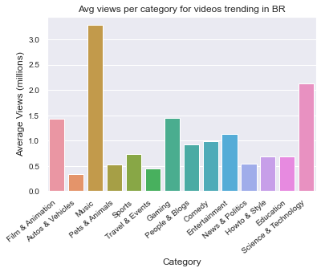

Slide 4
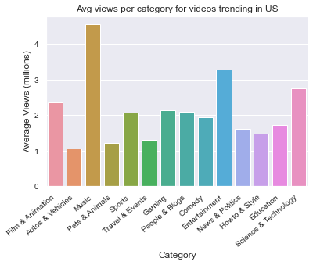

Slide 5
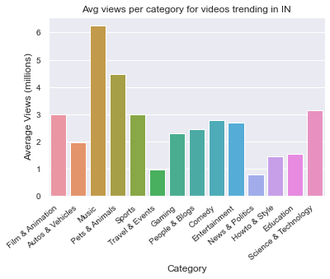

Slide 6
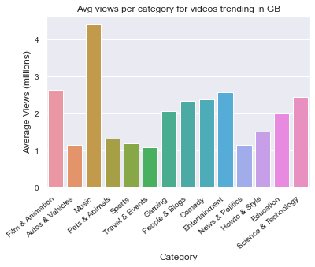

Slide 7
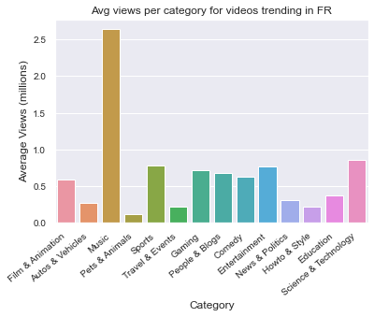

Slide 8
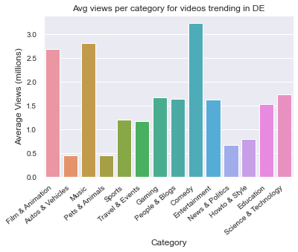

Slide 9
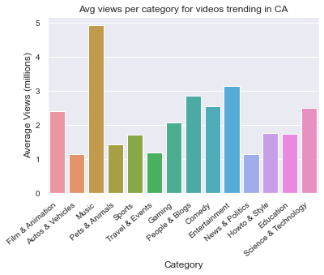

Slide 10
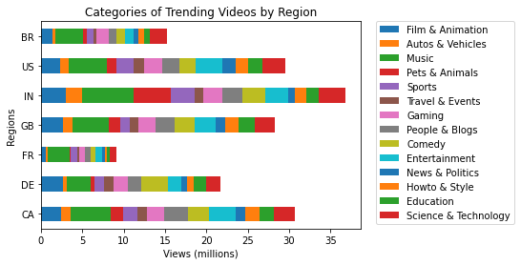

Slide 11
